Slide 1
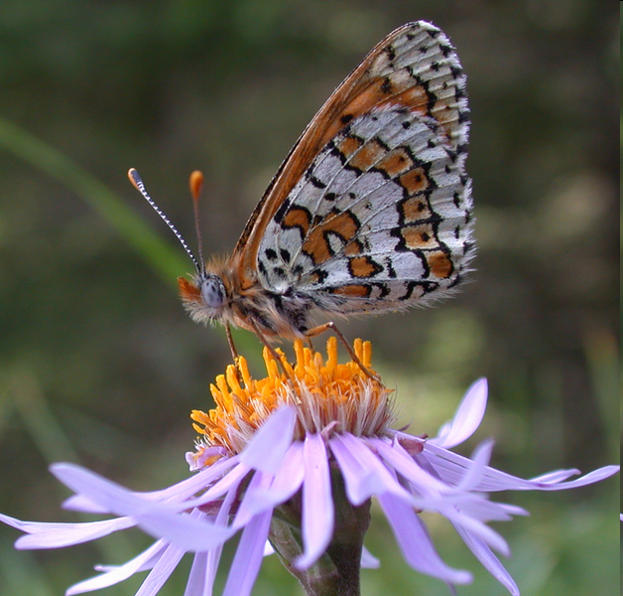
Glanville fritillary butterfly genomics and genetics
Rainer Lehtonen
PhD, Genomics and genetics project leader
Metapopulation Research Group
Department of Biological and Environmental
Sciences, University of Helsinki

Slide 2
Glanville fritillary butterfly – genomics and genetics
Background
Genome project
Genome assembly >> Panu Somervuo
Some NGS applications
Conclusions

Slide 3
Glanville fritillary as a model
Glanville fritillary is an internationally recognized metapopulation model system in ecological and evolutionary studies
Studied since 1991 in the Åland Islands in Finland
Data available from different populations:
Fragmented landscape vs. continuous
Isolated vs. metapopulation
Large vs. small
Same vs. different population history
Field studies, indoor & outdoor cage + laboratory experiments, controlled crosses, molecular studies

Slide 4
Collaborative genome project
DNA (+RNA) SAMPLES
INSTITUTE OF BIOTECHNOLOGY
SEQUENCE DATA PRODUCTION
INSTITUTE OF BIOTECH, KAROLINSKA INSTITUTE
QC + ASSEMBLY
INSTITUTE OF BIOTECH, DEP COMPUTER SCI
ASSEMBLY VALIDATION (ref g)
INSTITUTE OF BIOTECH, DEP COMPUTER SCI
ANNOTATION + PUBLICATION
EBI, ENSEMBL GENOMES
GENOME ANALYSIS
EBI, OTHER GENOME PROJECTS
VARIATION IN THE GENOME
INSTITUTE OF BIOTECH, DEP COMPUTER SCI
GENETIC TOOLS
FIMM, BIOMEDICUM HKI, INSTITUTE OF BIOTECH, ILLUMINA INC.

Slide 5
Reference genome + variation
NEX-GEN SEQUENCING
454, SOLiD3, SOLEXA
REF DNA +RNA SAMPLES
NEX-GEN RE-SEQUENCING
SOLiD4/SOLEXA
CROSSES/POP POOLS/INDS
GENOME ASSEMBLY
EST ASSEMBLY
MAPPING TO REF GENOME
VARIATION
ESTs
REF GENOME
GENETIC MAP
(MARKER LOCATIONS)
GENETIC VARIATION
GENE EXPRESSION
GENOME ANNOTATION
PLATFORM FOR LARGE SCALE TARGETED GENOTYPING
DATA FROM
OTHER SOURCES
GENOTYPING OF LARGE POPULATION SAMPLES (>50K)

Slide 6
Variation & other nex-gen data
Sample | Aim | Platform | Read Type | Read Length | Runs to be done
RNA, pool used in RNAseq | Gene start sites Gene 5’ variation | SOLiD4 | Pair-end | 50+25 | 1/4
Amp DNA, 4 crosses | Construction of genetic map | SOLiD4 | Single read, RAD tag library | 50+25 | 3
Amp DNA, pool ~30 ind | SNPs & other genetic variation | SOLiD4 | Pair-end | 50+25 | 1
RNA, pooled pop samples from 5+1 pop | Variation in 5+2 pop SNPs in ESTs, Expression | SOLiD4 | Pair-end | 50+25 | 1(-2)
DNA from selected individuals | Pgi & flanking genes + Sdhd, Hsp70 | Sure- Select + 454 Sanger seq | Single read | 400 | 1/4

Slide 7
Deep re-sequencing
RAD-tag (Restriction Enzyme Associated DNA) known also as
“Deep sequencing of reduced representation library”
Example: Construction of a high-density genetic map:
*4 controlled Spain-Finland crosses
* Parents and 50 individuals from each family to be sequenced
Genetic or linkage map defines an order and distance between markers based on a recombination frequency (1cM = 1% recombination rate) in meiosis
SureSelect (Agilent)Target Enrichment + deep sequencing with 454
Example: Population comparison of the Pgi + flanking genes (+ some other)
in a sample of 24 individuals or pools

Slide 8
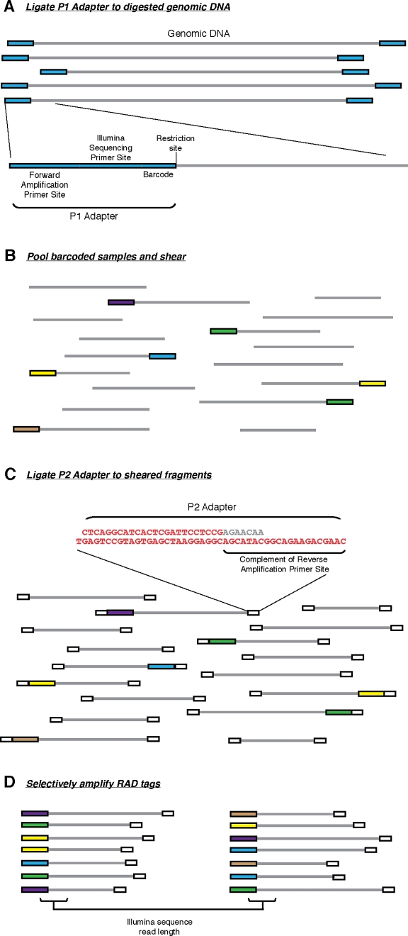
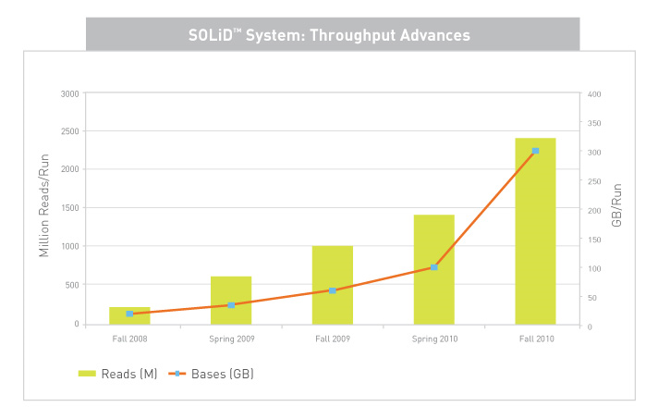
Genetic map with
RAD-tag NGS
Nathan A et al.
PloS ONE 2008
Now:
500M
Reads
50 bp each
150-200bp pair-end library
50bp seq
25 bp seq
SNP1
SNP2

Slide 9
RAD-tagging in Glanville fritillary
Average fragment size
454 Glanville gContigs Heliconius
NcoI 13.3 14
XhoI 11.5 4
EcoRI 4.5 2
Mappable reads
Restriction site > 250bp from the end of a gContig
Targets = 2x sites
454-Newbler assembly: 320Mbp (out of ~550Mbp genome in 220K contigs (>500bp)
Expected number of SNPs 1/300bp, read lenght 50-25bp
-----------------------------------------------------
#sites #mappable #exp #SNPs
NcoI* ccatgg 24,064 38,880 48,128 12,032
XhoI ctcgag 27,788 45,925 55,576 13,894
EcoRI gaattc 70,474 117,293 140,948 35,2367
BsphI* tcatga 66,967 110,731 133,934 33,483
NdeI catatg 73,629 121,628 147,258 36,814
*The most probable combination > ~45,000 SNPs
Reads have to unique
10-20x coverage/ individual (>~5000x on average)
Heavy data filtering needed > probably only 30-50% of data is usable
In silico restriction analysis made by Panu Somervuo, MRG

Slide 10
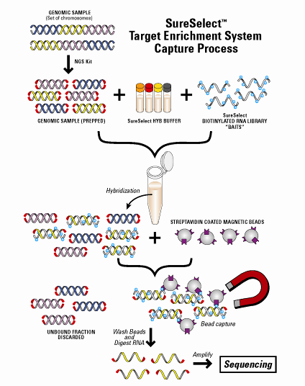
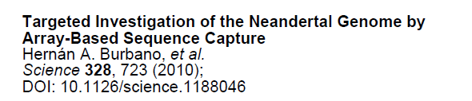
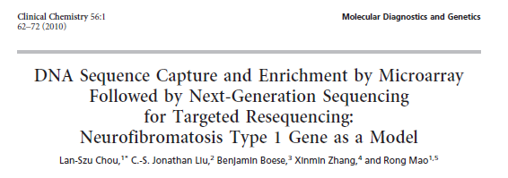
Targeted enrichment + resequencing
Max 55K 120 mer
oligos
Glanville fritillary butterfly SureSelect
Target enrichment (10x tiling):
To identify “lethal” haplotypes associated
to a known homozygous genotype
To define structure and variations of the
hypervariable Pgi gene
* To design tag-SNPs for large scale genotyping

Slide 11
Uneven coverage
¼ 454 Titanium run: 444-12197 kb/sample = 15-406 x coverage
Figure by Pia Laine
Institute of Biotechnology
University of Helsinki

Slide 12
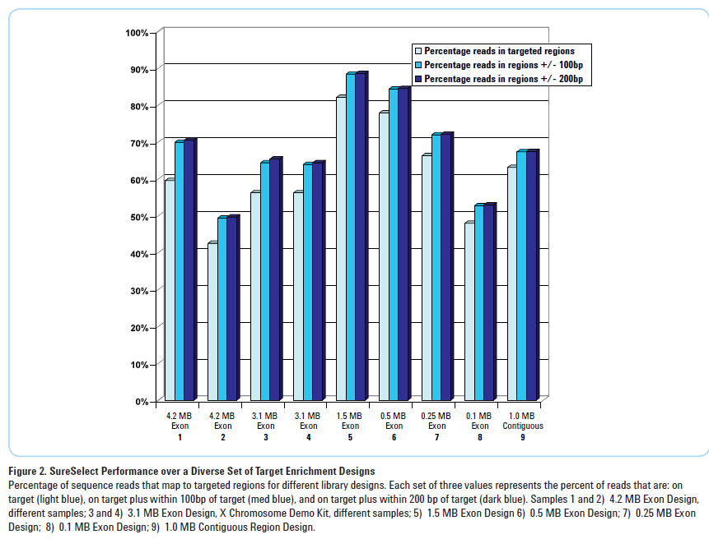
How well SureSelect works?
Our very preliminary result:
~40% of the data
comes from the target
Data from Agilent

Slide 13
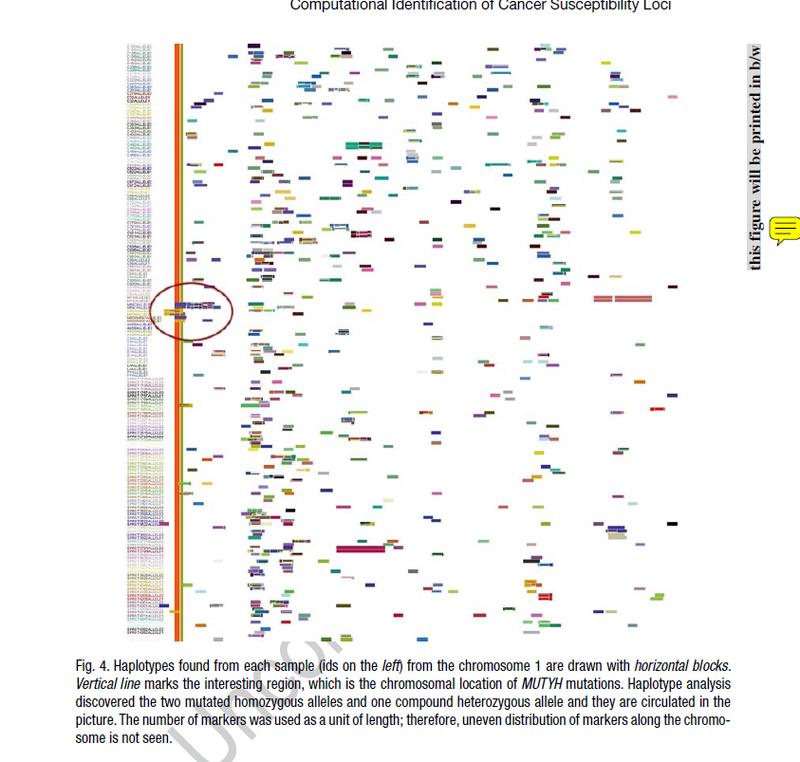
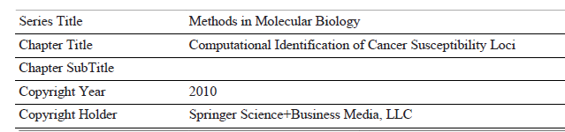
Comparison of haplotypes
Sampsa Hautaniemi, Marko Laakso,
Sirkku Karinen, Rainer Lehtonen
Sirkku.Karinen@helsinki.fi

Slide 14
Message
Whole genome sequencing is doable for a “non-genome” oriented research group
Most work on data filtering and analysis
Tools for data management and analysis under strong development
Down-stream efforts need to be compatible with available genome data

